Slide 1
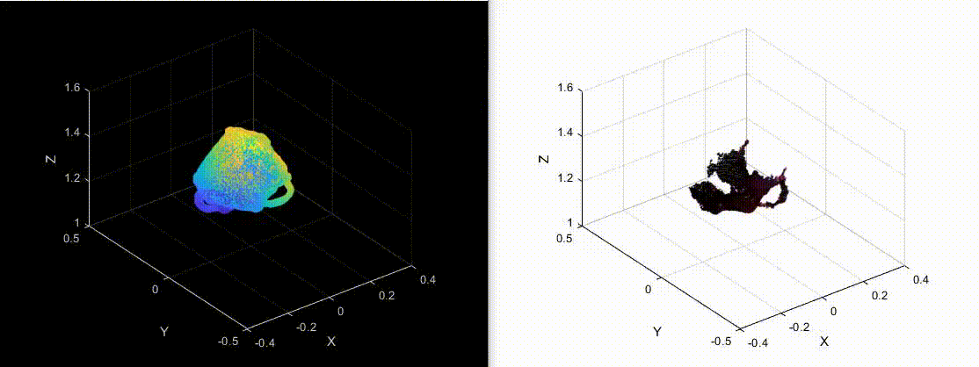
3D Motion and Object Reconstruction
By Bharath S, Isaac K, Chase A

Slide 2
Overview
Goal
Recreate Object Motion in 3D space from RGB-D video
Approaches
Initialization Method
Non-Initialization Method
Object of Choice: Backpack
Asymmetric, Large, Detailed

Slide 3
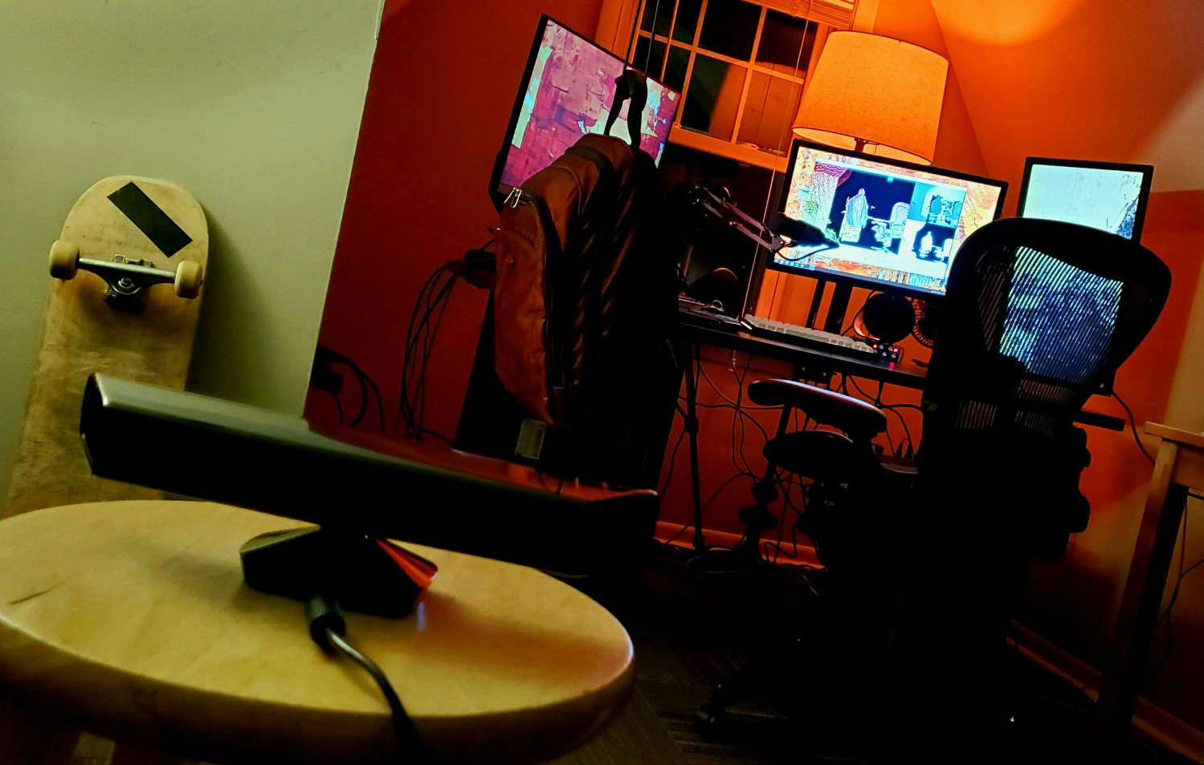
Data Acquisition Environment (ignore cable management)
Notes:
Here we can see our data acquisition environment, this consisted of a free hanging backup strung upon a cable as well as the XBOX 360 kinect connected to MATLAB using the MATLAB’s image acquisition toolbox.

Slide 4
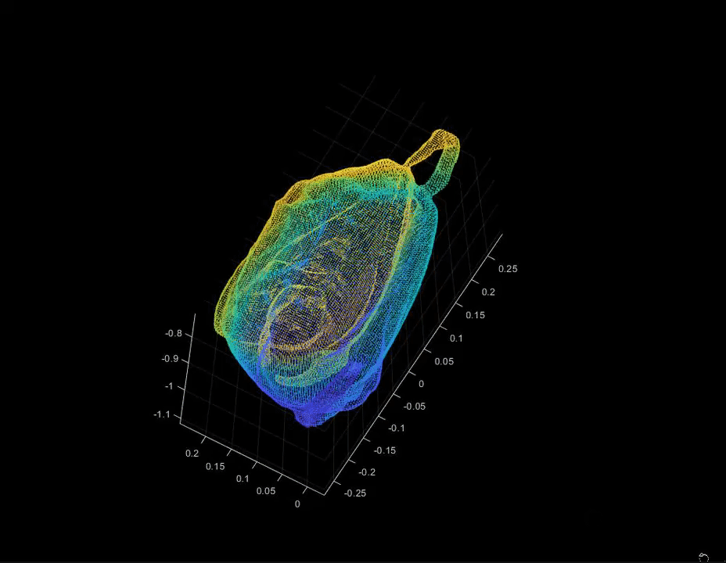
Baseline 3D Scan for Initializing Transforms
Notes:
This was our high fidelity, high resolution, 3D point cloud model using the Kinect SDK. This will be used in our method 1.

Slide 5
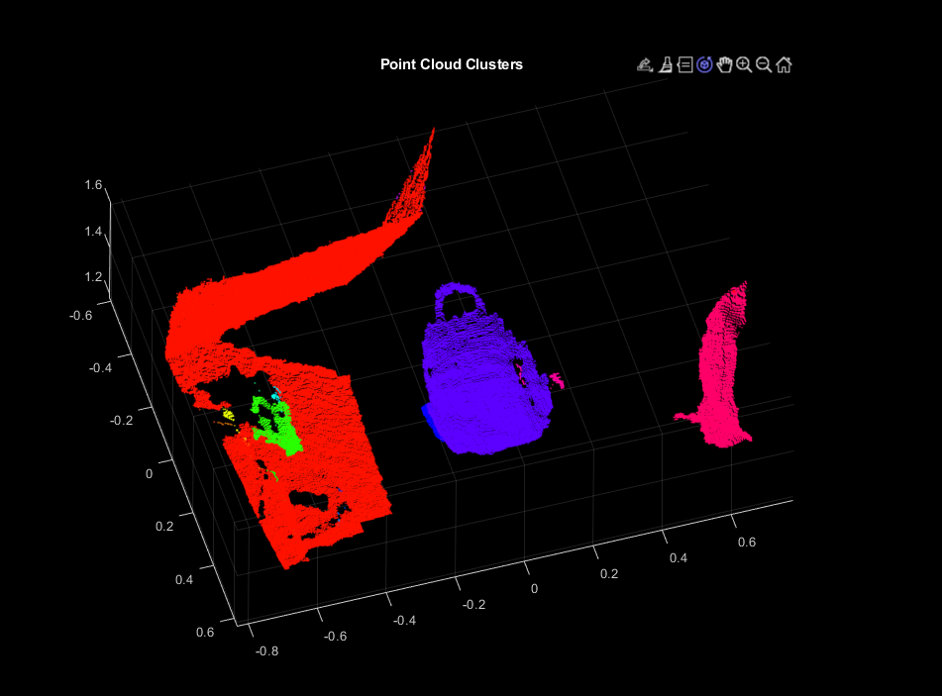
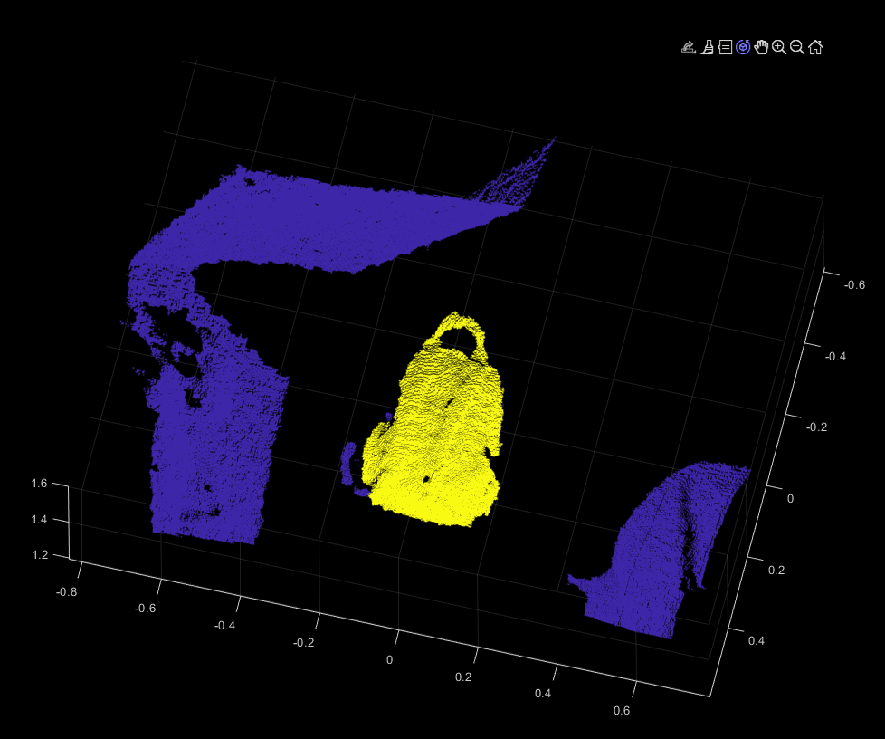
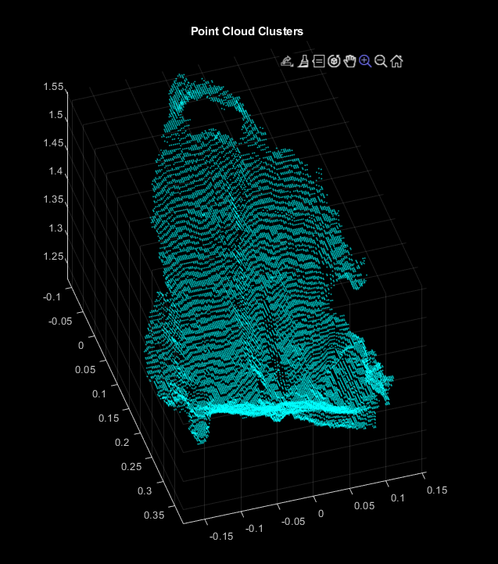
Backpack Isolation
Notes:
For each depth and color entry acquired from the kinect we had this preprocessing method
Threshold for depths in scope of desired object motion
Create joint point cloud of all objects in sensor’s and depth view
Segments point cloud and filter for prominent object in center frame
Calculate mode of center point labels to determine the object of interest PC
These images represent our point cloud preprocessing, on the left we see the joint point cloud using depth thresholding. On the right

Slide 6
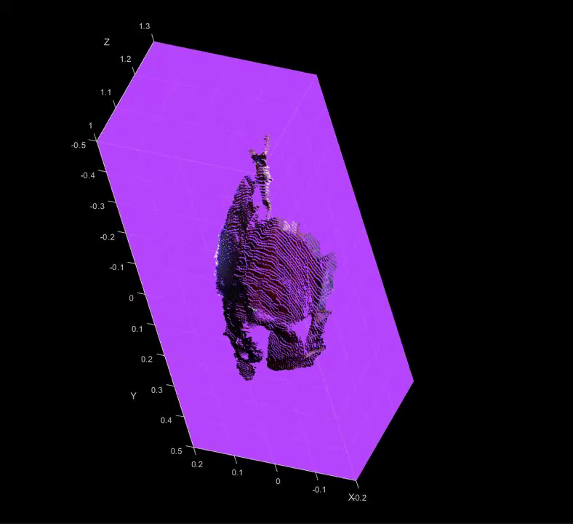
Depth Video Example

Slide 7
Method 1: Initialization Method
3D scan of backpack using Kinect SDK
Downsample by 50%
Manually translate and rotate model to be close to first frame
Otherwise there were many instances of getting stuck in local minima
Do ICP between frame 1 and model, transform model
Repeat ICP and model transform till all transforms are computed and saved

Slide 8
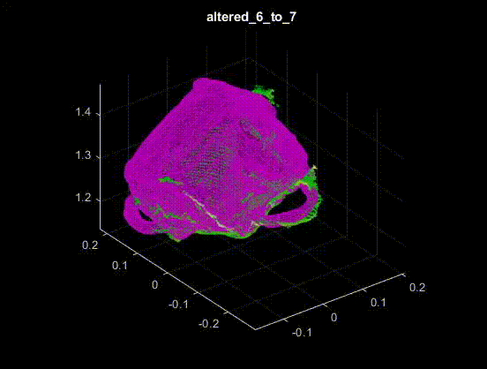
Progressive ICP Frames

Slide 9
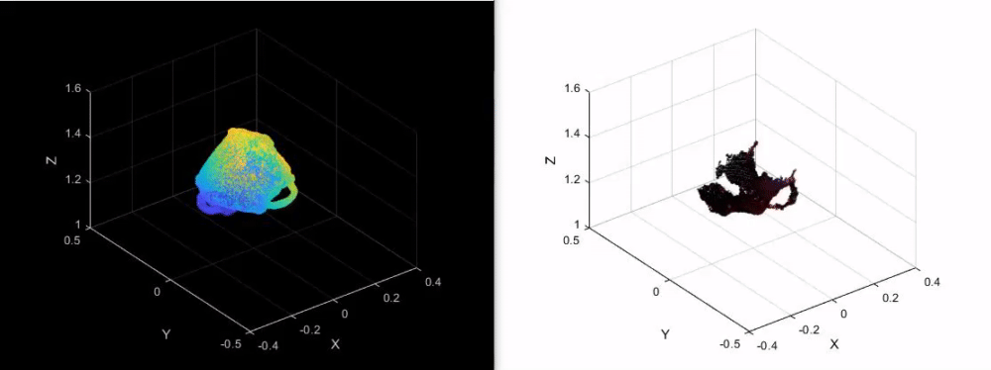
Successful Motion Recreation

Slide 10
Method 2: Non-Initialization Method
Method
Obtain 3D Model
Loop through consecutive RGB-D point clouds
Perform ICP to obtain transform between each consecutive frame
Calculate transform from latest frame back to initial frame
Merge point clouds
Display Motion
Loop through and apply transformations to completed 3D model

Slide 11
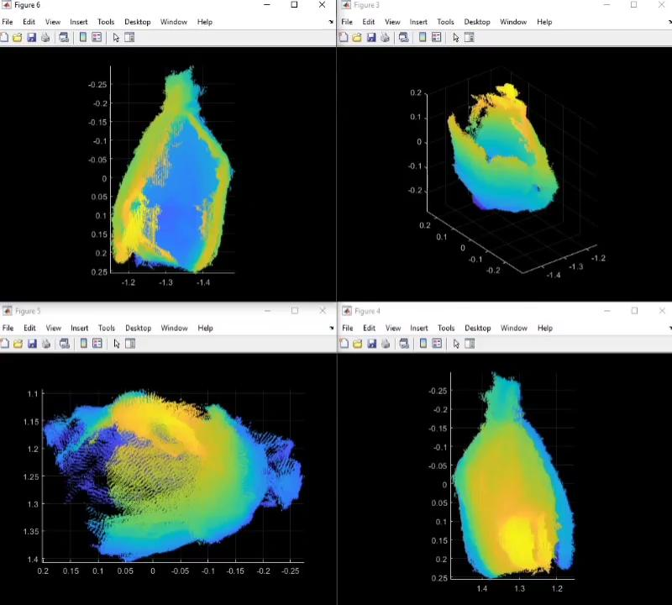
3D Object Recreation Using Depth Video and ICP

Slide 12
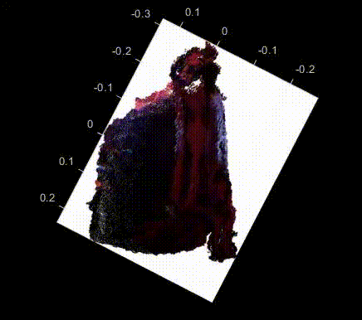
3D Object Recreation Using Depth Video and ICP

Slide 13
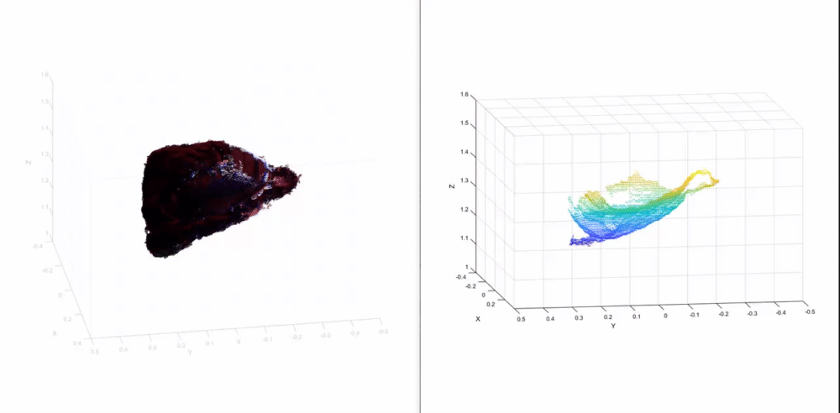
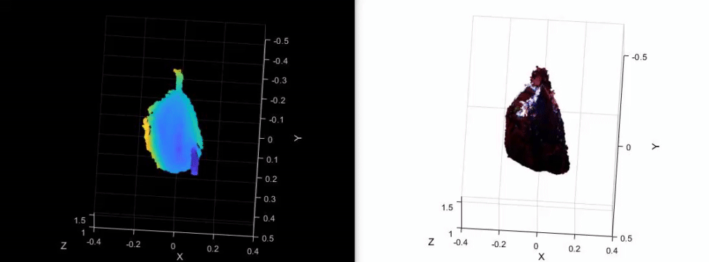
3D Object Recreation and Object Motion Tracking

Slide 14
Questions?

Slide 15
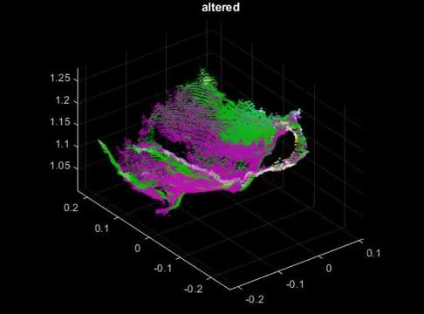
Progressive ICP Frames

